Slide 1


Solibri Rulesets

Slide 2
Solibri Rulesets
What do I need to check?
I need to check the agreed deliverables from the model, generally coordination and data
When do I check?
At each model upload.
How should I communicate the results?
Through open standards such as BCF files. And progress markers.
Should I check anything else?
Nope!
How?

Slide 3
Solibri Rulesets
Clash detection.
Is this thing touching that thing
The best way is the easiest way and the most easily repeatable way
Archi Vs Structural
Archi Vs MEP
Archi Vs Archi
Archi Vs Landscape
Structural Vs Structural
MEP Vs MEP
Landscape Vs Landscape
Structural Vs MEP
Structural Vs Landscape
Landscape Vs MEP

Slide 4
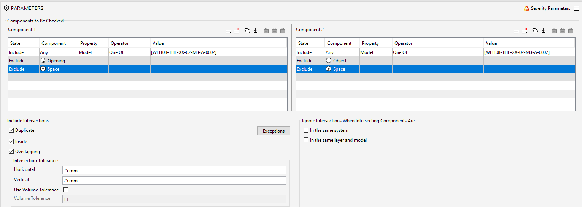
Solibri Rulesets
So Archi Vs Archi is my first check
The standard rule check is this
Exclude spaces and openings, and use 25mm tolerance *

Slide 5
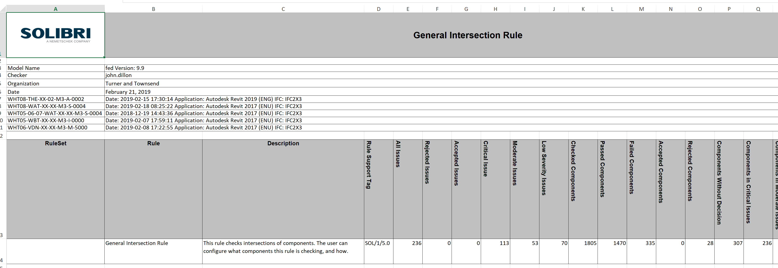
Solibri Rulesets
But my report gives me useless data
Its just overall numbers
It doesn’t tell me anything

Slide 6
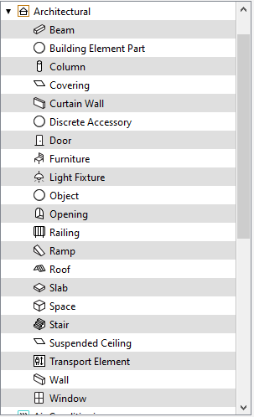
Solibri Rulesets
There has to be a better way to do Archi Vs Archi
Looking at the Archi component list there are 19 components I care about.
Excluding ‘Opening’ and ‘Space’.
If I spent some time breaking down the rules then would I have usable data

Slide 7
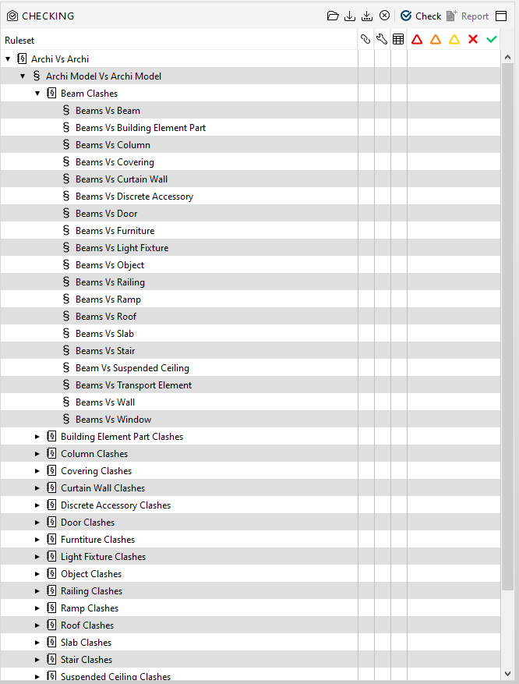
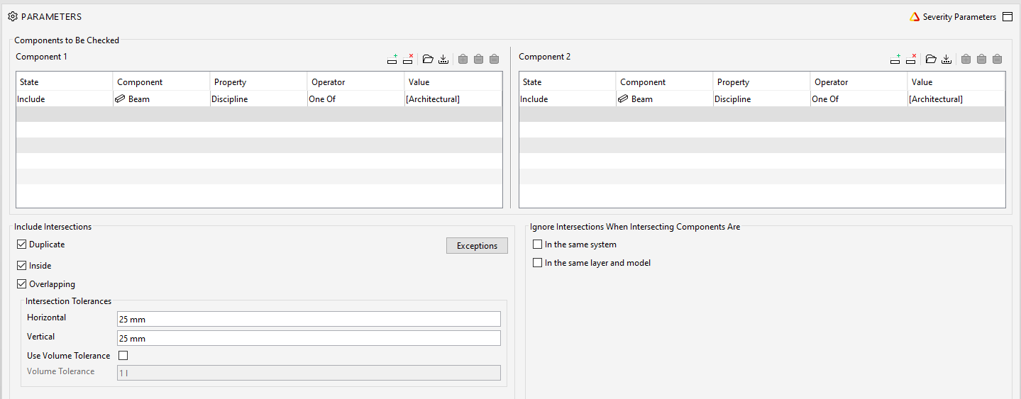
Solibri Rulesets
Every component against every other component
Formatted to exclude duplicates by just removing them. No exclusions
My report should look a little different now

Slide 8
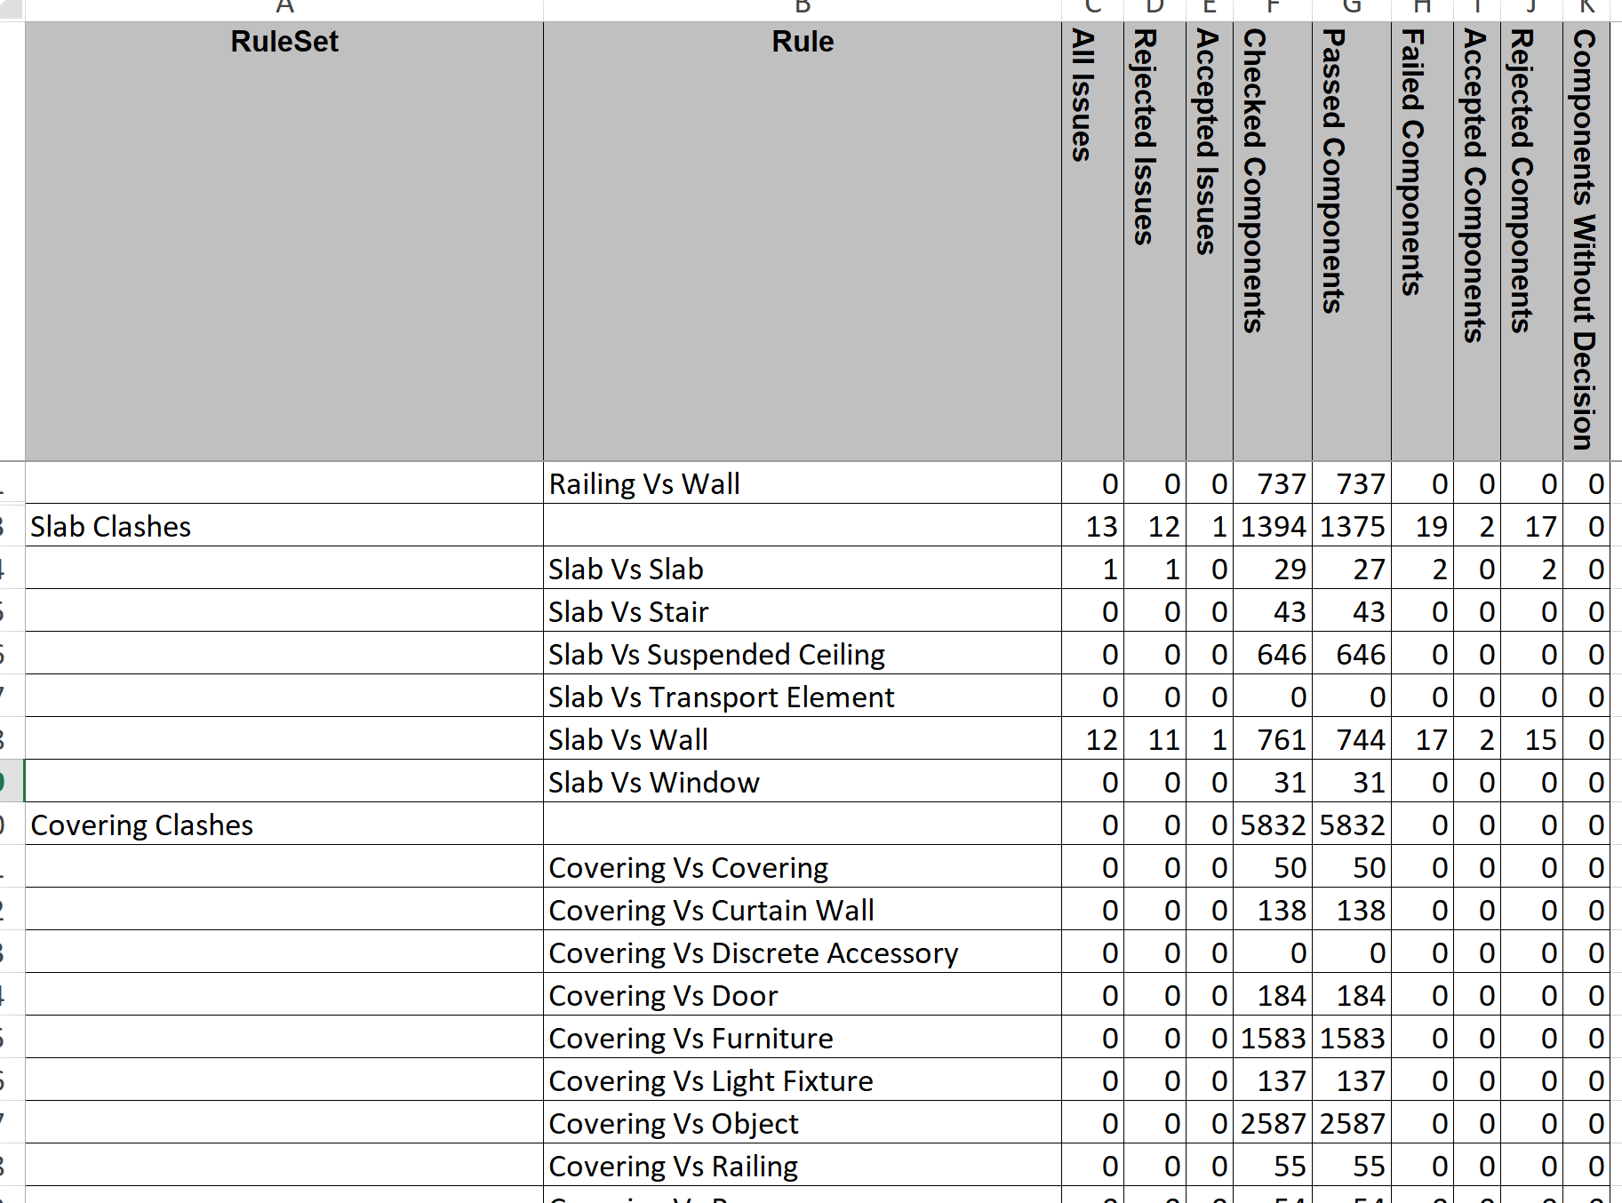
Solibri Rulesets
And it does……
I now have a component by component report
Which is handy if I want to communicate

Slide 9
Solibri Rulesets
Plug this detailed data into Power Bi and the data can tell a story
The client doesn’t care about numbers. They want to be informed. What, when, who, why. How do we address the trend

Slide 10

Solibri Rulesets
Ive done this for every clash check that could ever be…….
Archi Vs Structural
Archi Vs MEP
Archi Vs Archi
Archi Vs Landscape
Structural Vs Structural
MEP Vs MEP
Landscape Vs Landscape
Structural Vs MEP
Structural Vs Landscape
There are over 4000 rules for MEP Vs MEP, at least 10,000 rules in total. Time consuming to write them???
Landscape Vs MEP

Slide 11
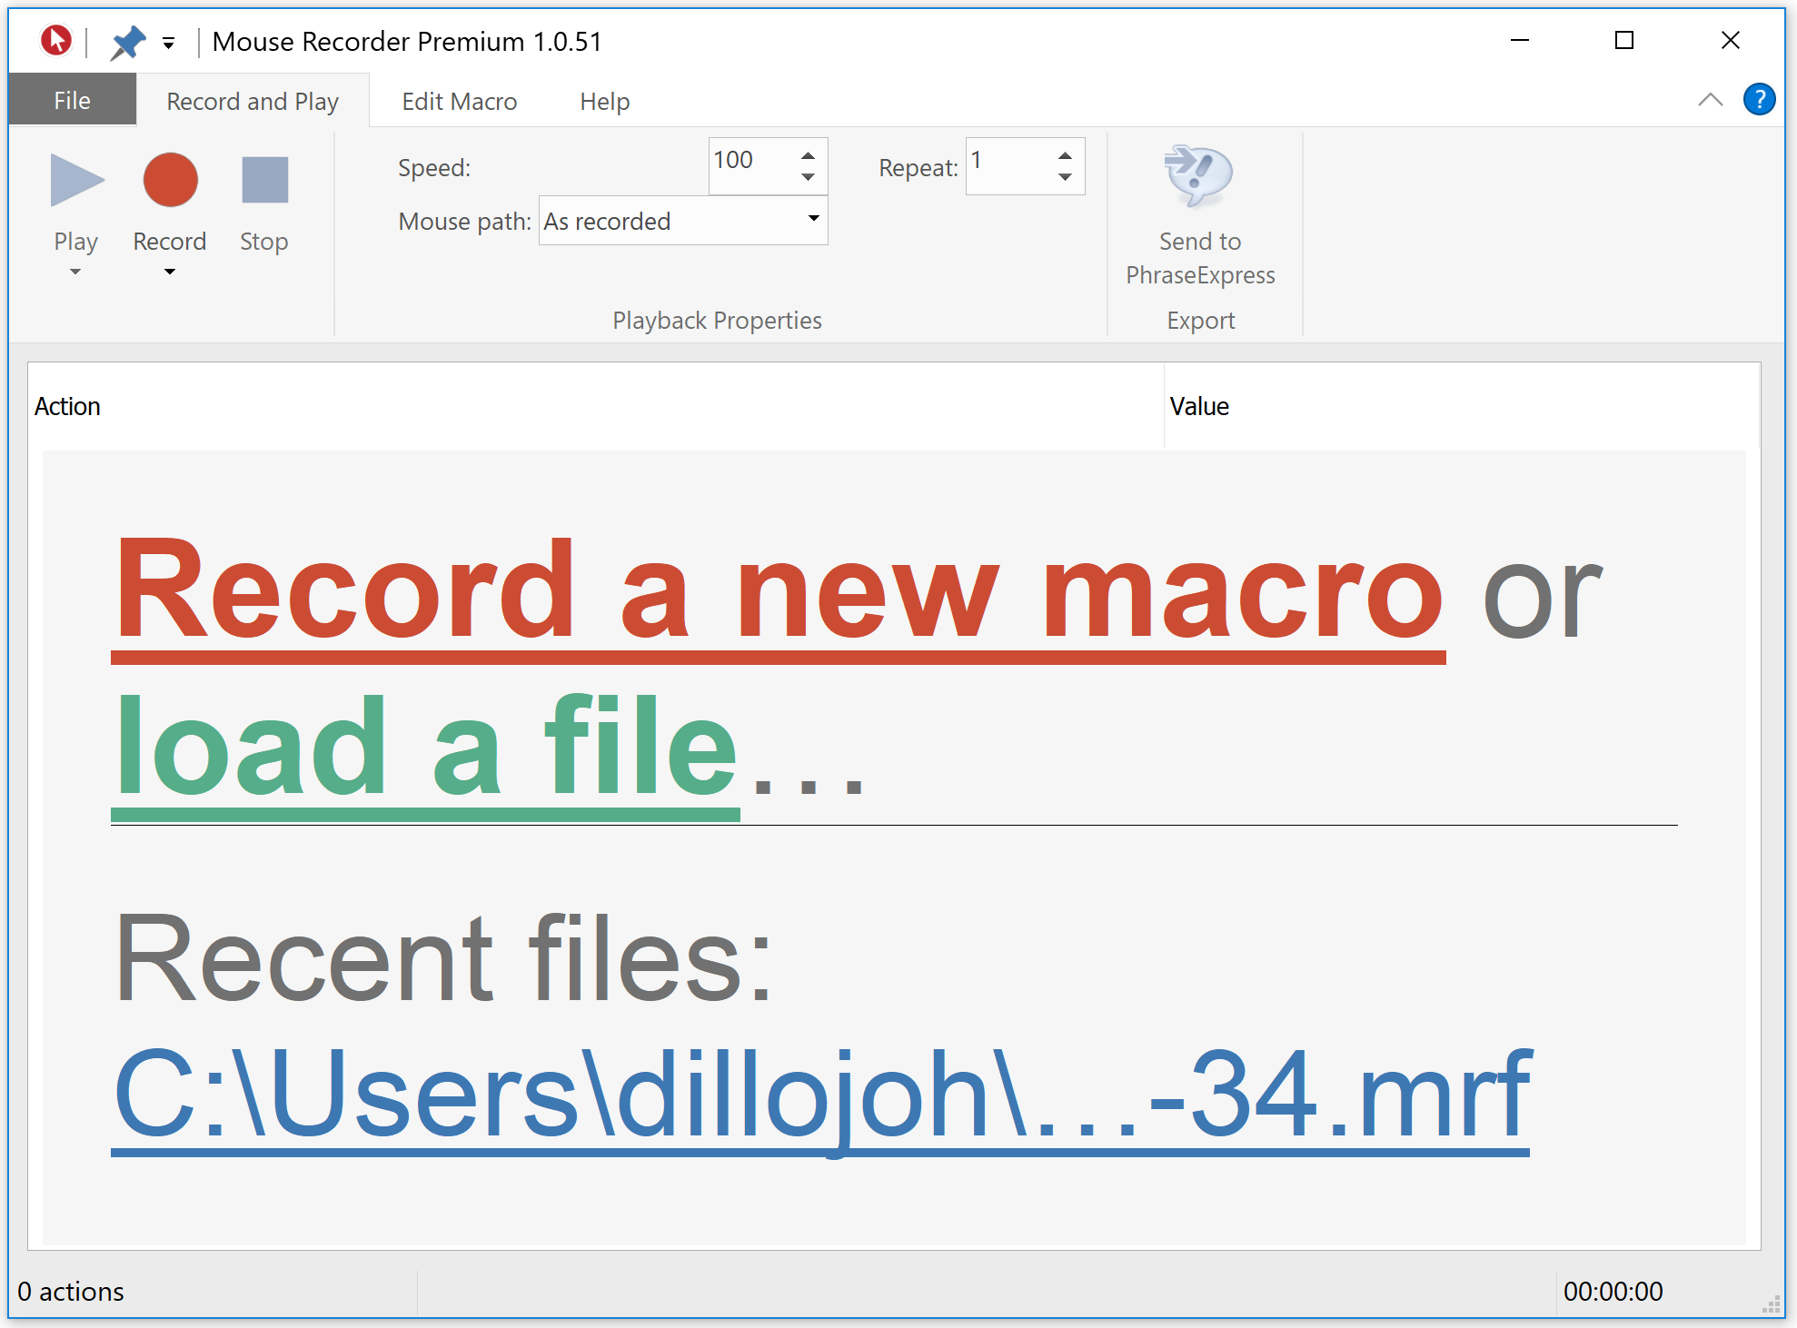

Solibri Rulesets
It would take months to create 10,000 rules
I used a mouse recorder to do it for me

Slide 12
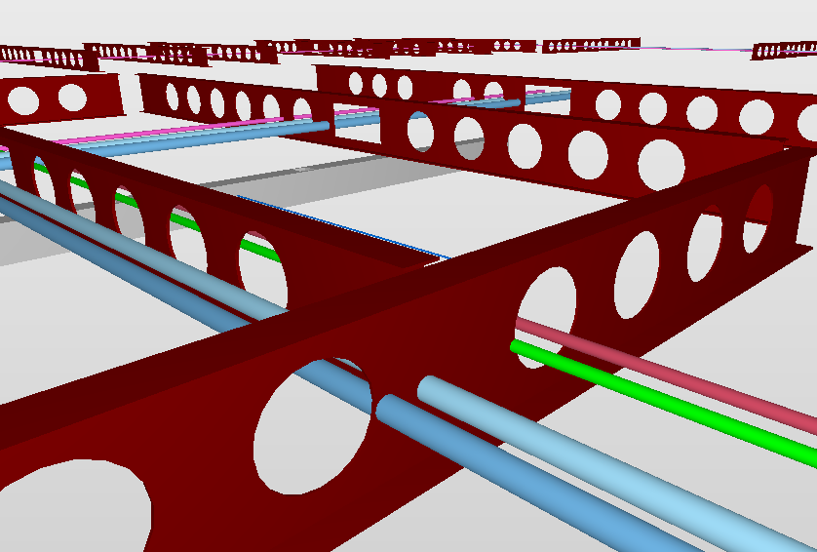
Solibri Rulesets
Tolerances.
Sometimes tolerances need to be appropriate to the components
These clashes don’t show at 25mm
Adjust to suit.

Slide 13
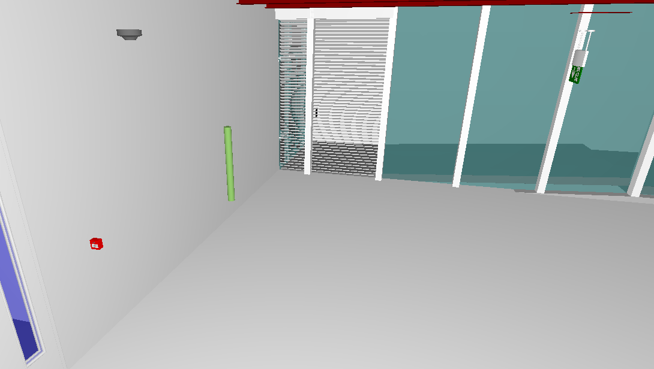
Solibri Rulesets
So that’s clashes covered.
What about non clashes
Everything in every building touches something. Nothing floats.
I have to find the floaters, and graph them.

Slide 14
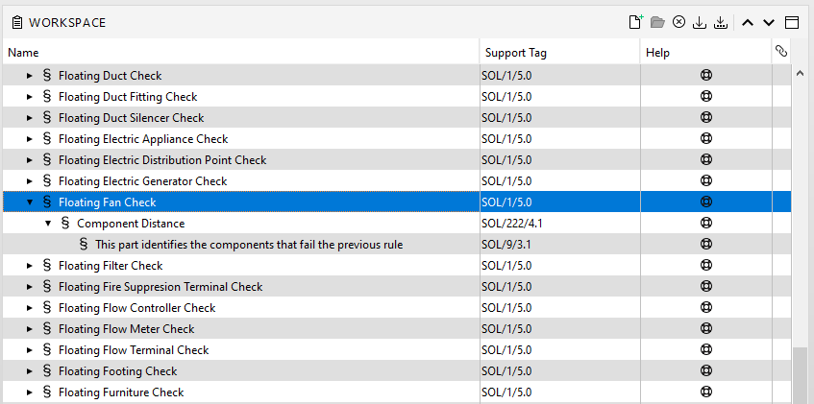
Solibri Rulesets
How do you find things that don’t touch other things
You need a rule within a rule within a rule. A triple gateway rule

Slide 15
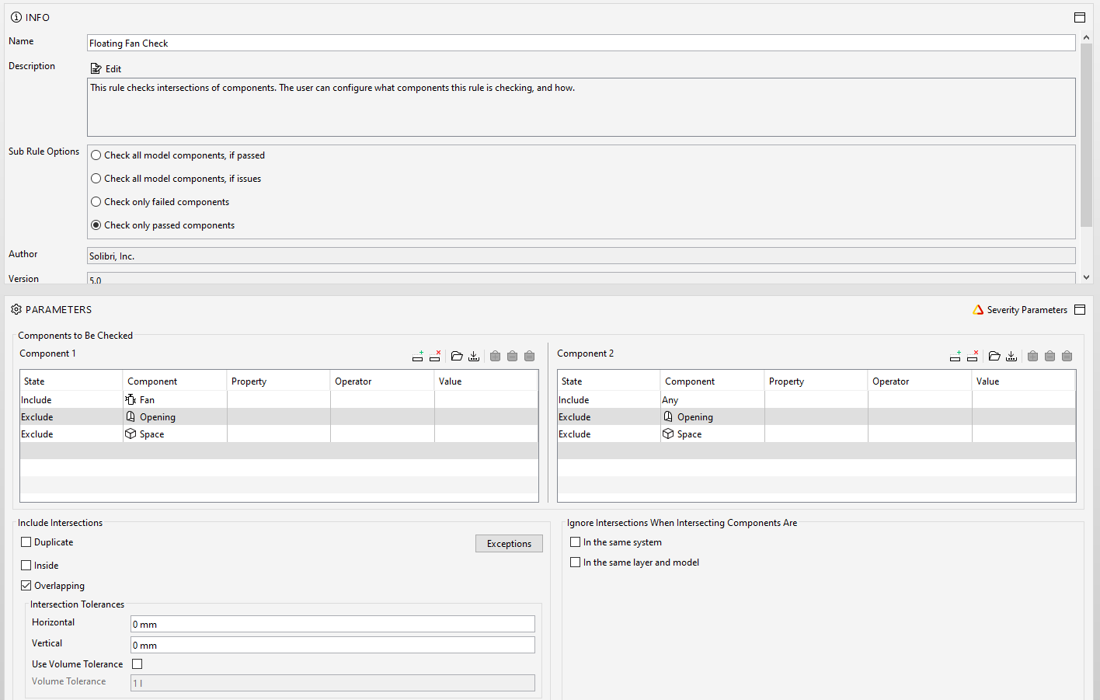
Solibri Rulesets
1st Rule
Find things that don’t clash

Slide 16
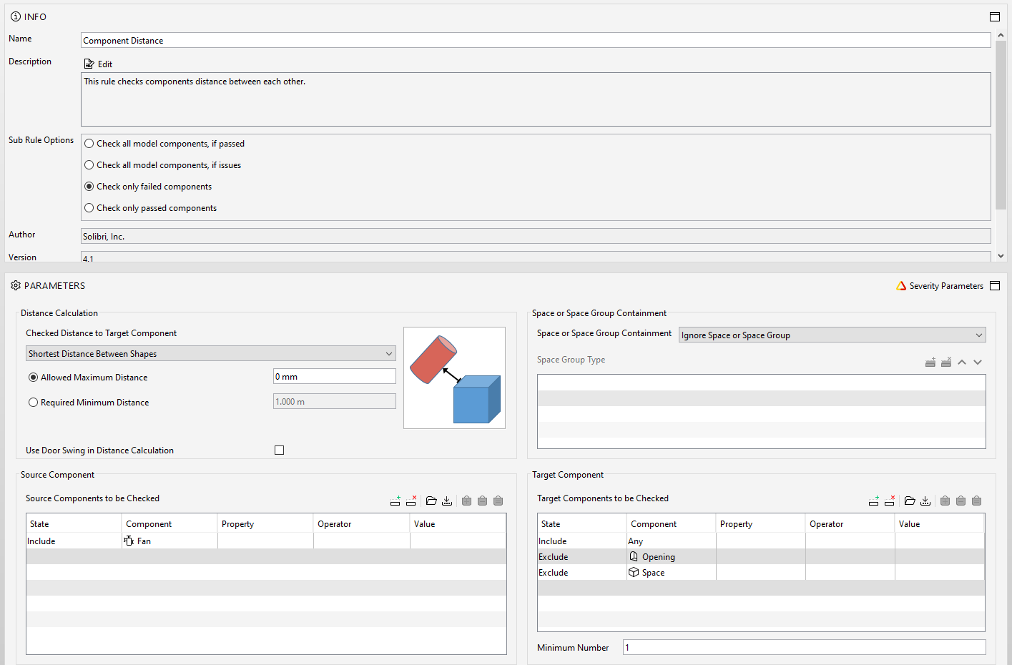
Solibri Rulesets
2nd Rule
Of the non clashers which ones are not touching perfectly

Slide 17
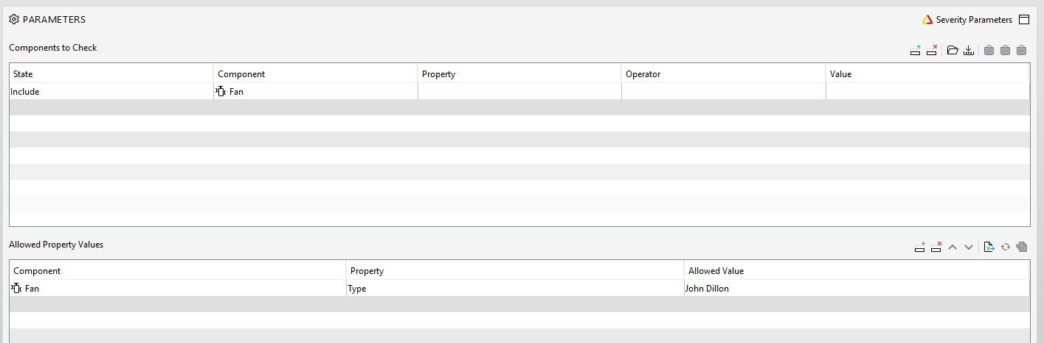
Solibri Rulesets
3rd Rule Show the items
The rule takes hours to check every possible floater, so possibly target the component types you are interested it

Slide 18
Solibri Rulesets
Clashes and non clashes done.
Some basic coordination checks to add……
Door swings.
Lintel clashes
Containment space
Others
Others
Others

Slide 19
Solibri Rulesets
Clashes and non clashes done.
Basic coordination checks done
Data checks to do……….
Predefined Type
Uniclass
COBie

Slide 20
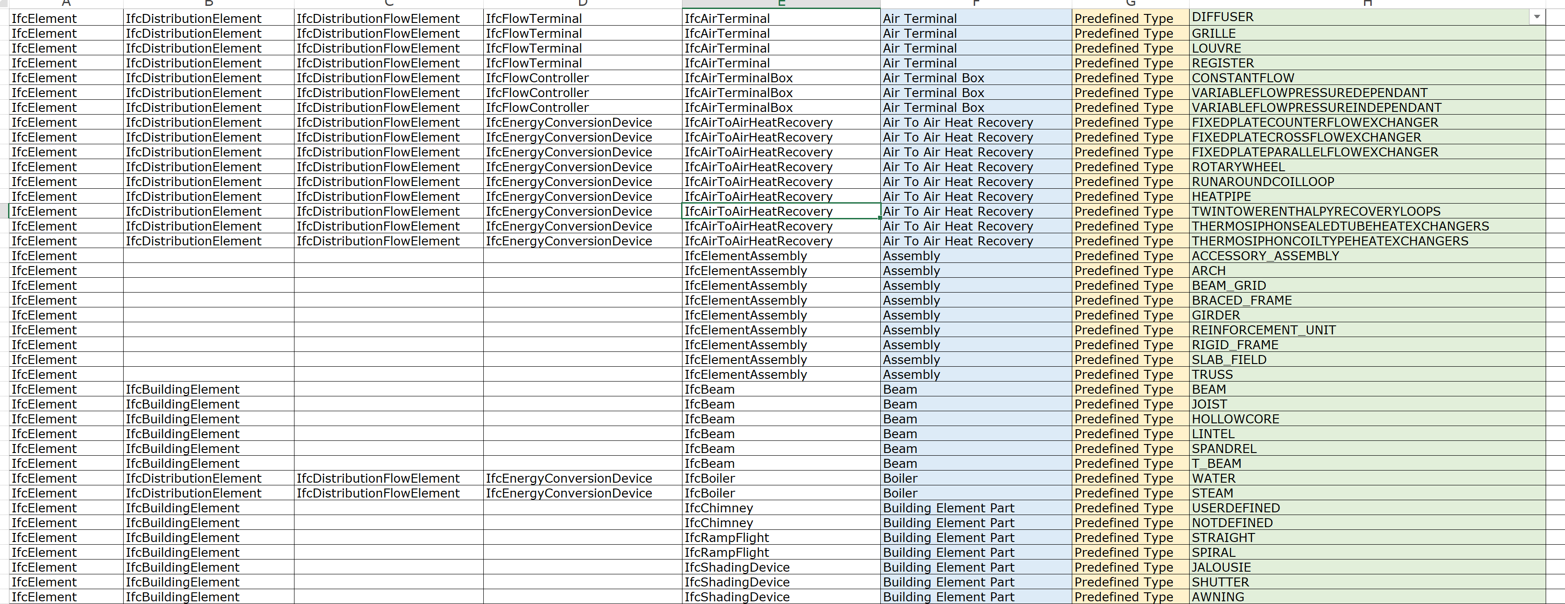
Solibri Rulesets
Data can be done by checking that components have data from an agreed list

Slide 21
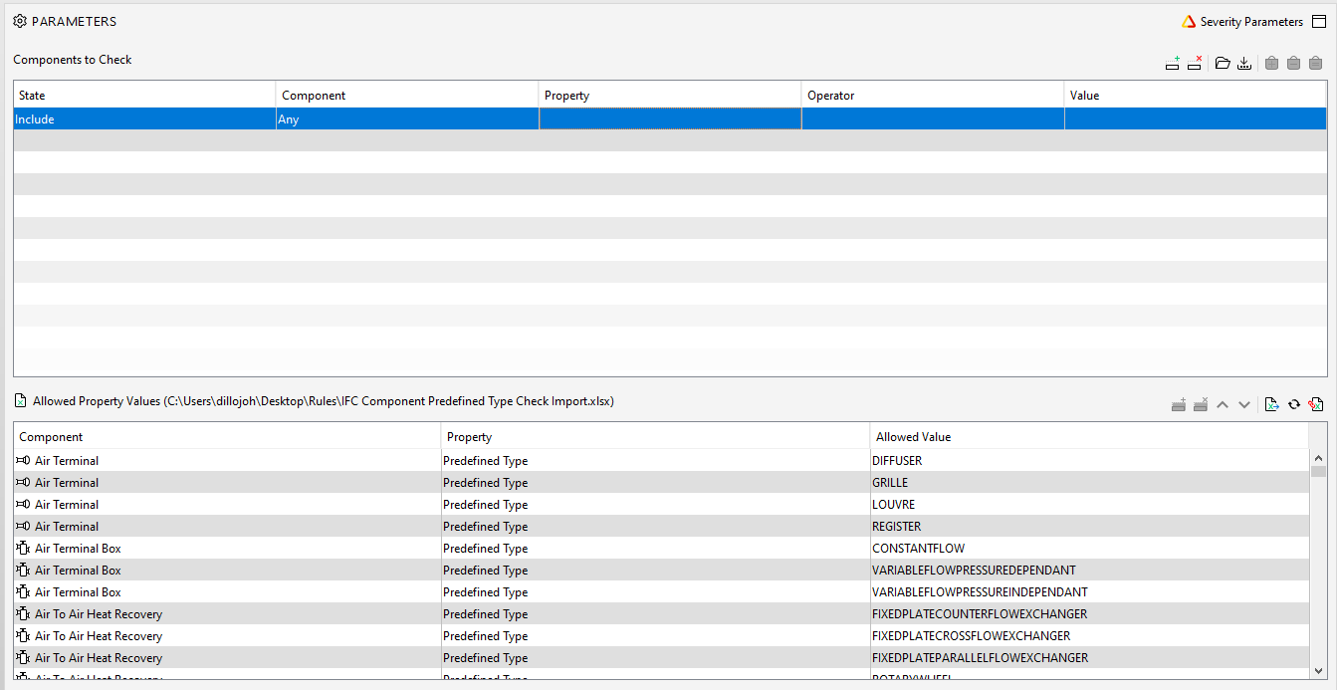
Solibri Rulesets
Plugging this list into Solibri allows me to identify any component with a property not on the list

Slide 22
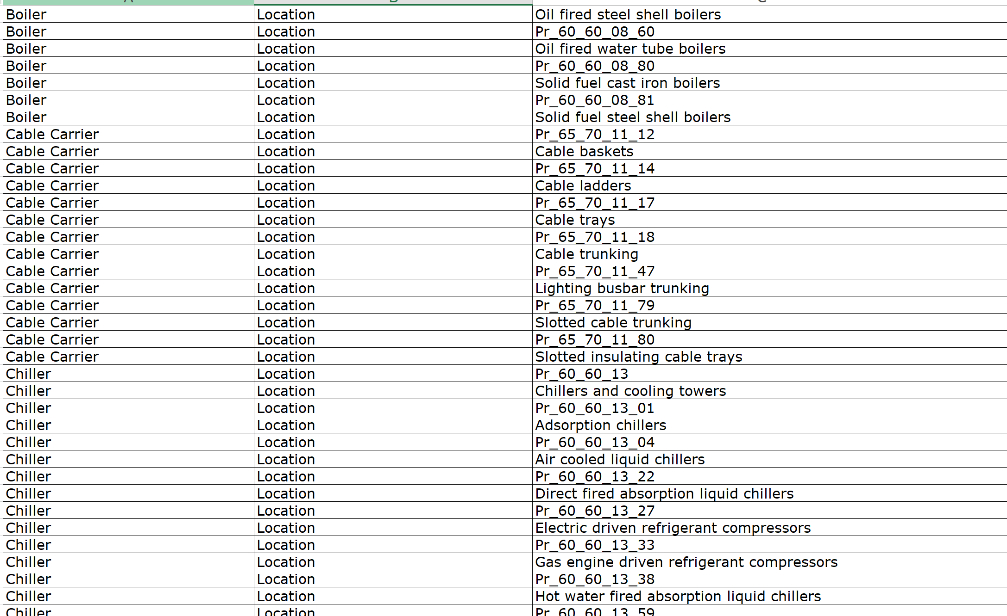
Solibri Rulesets
Same for Uniclass………. For every component. Ongoing

Slide 23
Solibri Rulesets
Same for COBie……………To do

Slide 24

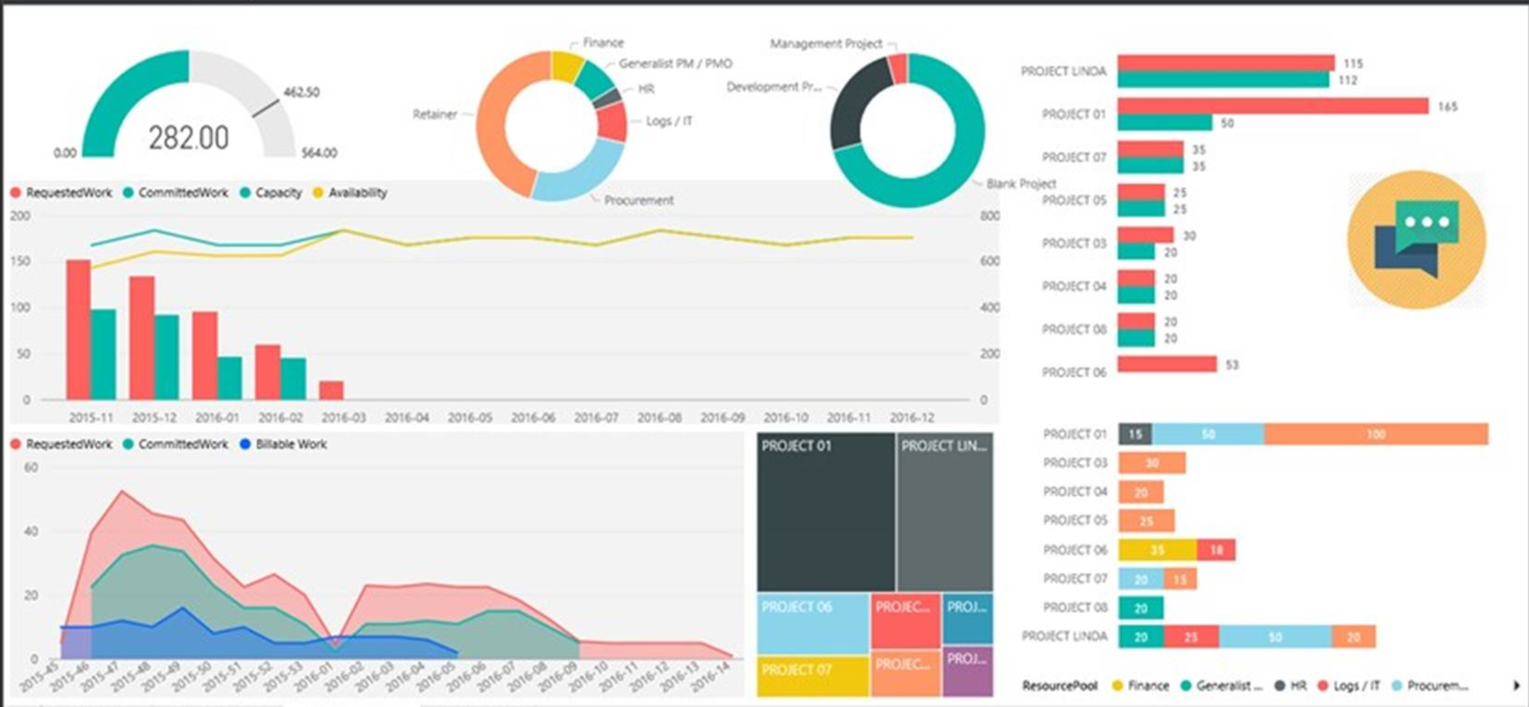
Solibri Rulesets
And all of these data checks can be fed to Power Bi too
Trustworthy, easy, repeatable, trackable and presentable checks.
In client friendly graphs

